Slide 1
PlatformIO
Microcontroller Development with a Proper IDE

Slide 2
What will we do today?
Introduction to Microcontroller Development
Common Microcontrollers
Introduction to PlatformIO
Install PlatformIO
Create a first demo project (LED blinking)
Work with the library manager
Create a more advanced Project (MQTT Messaging)

Slide 3
Microcontroller Development

Slide 5
What is PlatformIO?
Extension for many regular IDEs
Library Manager
Code Manager
Toolchain
Notes:
Folie einbauen Vorstellung ESP8266 & Mehr basics zum Thema DIE (ggf. Bilder zum Thema Microcontroller Programmierung)

Slide 6
Why PlatformIO?
Arduino IDE sucks!
Support for over 200 boards and platforms
Integrated in your favorite IDE
Automated toolchain installation
Library Manager! (Including Updates!)

Slide 7
Installation
Go on https://platformio.org/platformio-ide
Choose your IDE
Recommendation: Visual Studio Code
Follow the Instructions
Get a coffee
Done

Slide 8
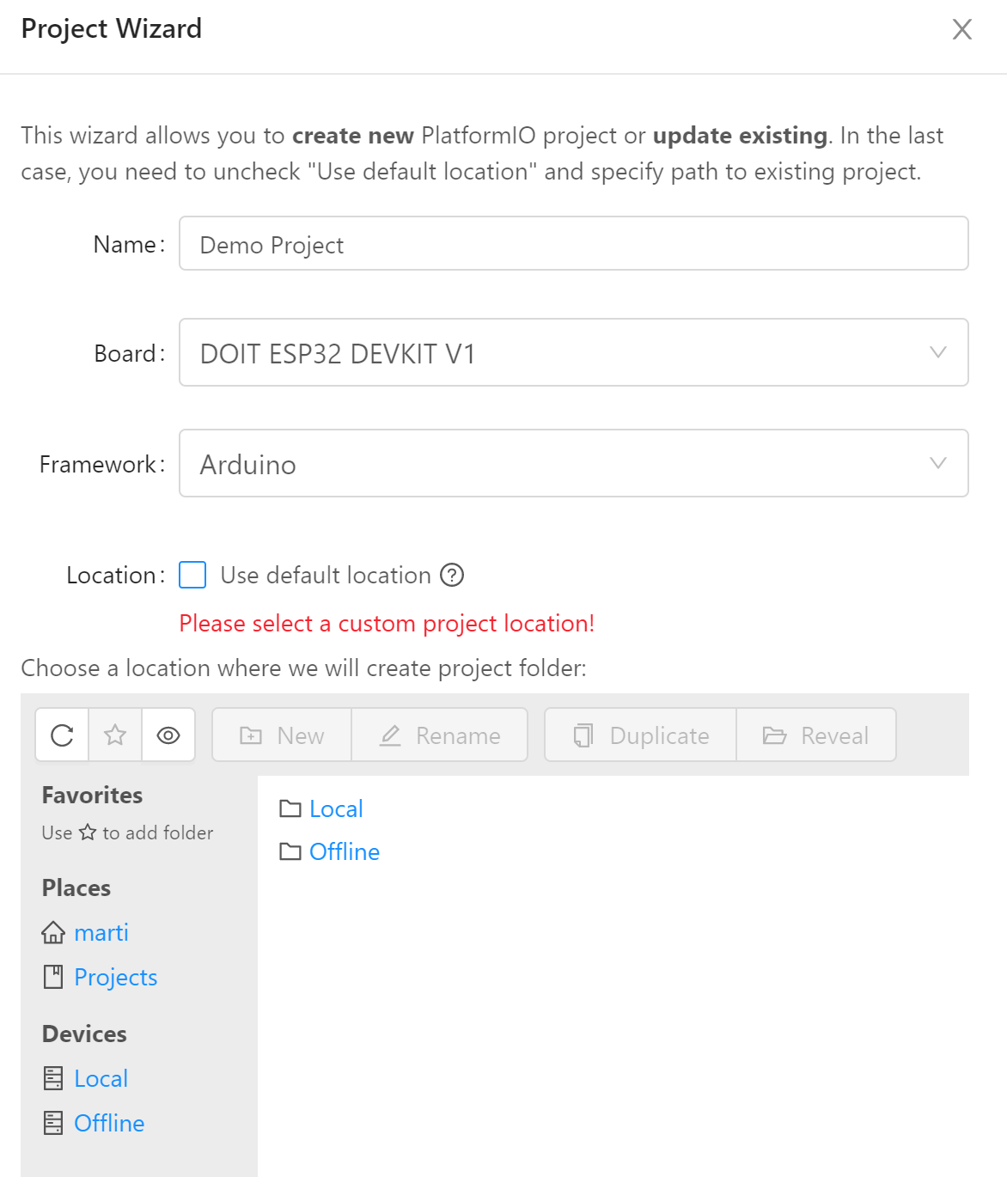
First Project - Start
PIO Home → New Project
Project Wizard
Name your project
Select your board (You can search)
Select the Framework
Select the Location (or keep default)
Grab a coffee
Switch back to your workspace
Open src → main.cpp

Slide 9
First Project – Code
/*
* Blink
* Turns on an LED on for one second,
* then off for one second, repeatedly.
*/
#include <Arduino.h>
void setup()
{
// initialize LED digital pin as an output.
pinMode(LED_BUILTIN, OUTPUT);
}
void loop()
{
// turn the LED on (HIGH is the voltage level)
digitalWrite(LED_BUILTIN, HIGH);
// wait for a second
delay(1000);
// turn the LED off by making the voltage LOW
digitalWrite(LED_BUILTIN, LOW);
// wait for a second
delay(1000);
}
Include Arduino.h
In your setup():
Define LED_BUILTIN as output
In your loop:
Turn LED_BUILTIN low
Wait 1 second
Turn LED_Builtin High
Wait 1 second

Slide 10
First Project – platformio.ini
Contains your project settings
Autogenerated, but can be adjusted
Important addtions:
upload_port
Specifies the port to upload the code to
Can be a COM port (for serial uploads)
Can be a hostname (OTA updates)
monitor_port
Specifies the serial port to monitor
For debugging
lib_deps
Tells the IDE, which libraries are needed
[env:esp32doit-devkit-v1]
platform = espressif32
board = esp32doit-devkit-v1
framework = arduino
upload_port = COM5
monitor_port = COM5
lib_deps =
ArduinoJson

Slide 11
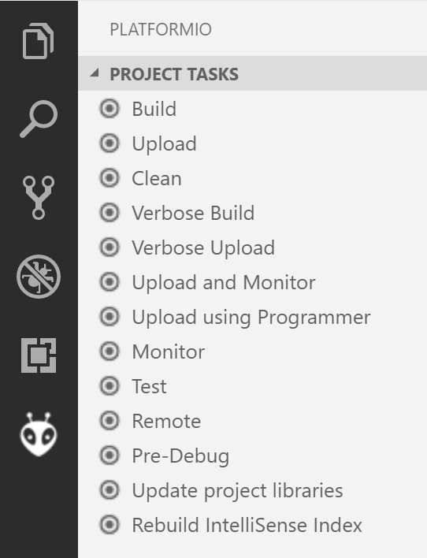
First Project – Build and Run
Use the Toolbar:
Or: Use the PIO Button (See right)
Build (and check the results)
Upload to the board
Enjoy a blinking LED (or start debugging)

Slide 12
Library Manager - Install
PIO Home → Libraries
Search, Install and Update libraries
Example: Search for „PubSubClient“
This is the most reliable MQTT Implementation
Click on the library
Hit „Install“
Check the examples!

Slide 13
Library Manager – Install via git
Sometimes a library is not in the manager
Sometimes you need a fork
Example: VS1053 Fork for the ESP
https://github.com/danclarke/Adafruit_VS1053_Library
Go to the Library Manager
Click „install“ (without searching)
Enter the URL for the git repo
Note: This puts the library into .piolibdeps
→NOT shared on git!

Slide 14
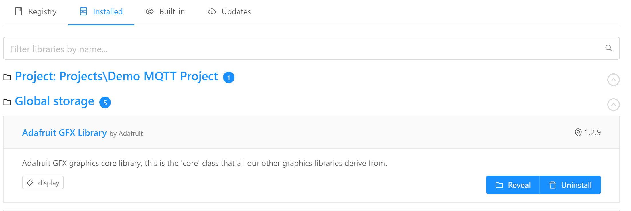
Library Manager – Installed Libs
Get an overview on installed libraries
Access examples
Global Storage & Project Storage

Slide 15
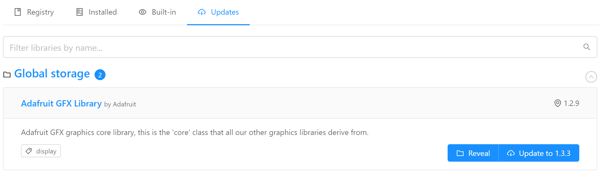
Library Manager – Update Libs
Automatic detection of updates
Update library with 1 click

Slide 16
Next Project – MQTT Messaging
MQTT is a lightweight messaging protocol
Central Broker (server) handles messages
Clients:
Subscribers can subscribe to topics
Publishers can publish messages to topics
Used widely in IoT applications

Slide 17
MQTT Project – Structure
Based on the Example from the library!
Connect to the WiFi
Setup:
Connect to the MQTT Server
Subscribe to your topics
Loop:
Handle messages: client.loop();
Publish something
WiFi SSID: „CoMakingSpace“
Password: just ask ;)
mqtt_server = "comakingcontroller"
Notes:
Folien einbauen zum debuggen via Serial Port

Slide 18
Thank you!
Notes:
Aufgaben einbauen zur Interaktion mit Sensoren / der echten Welt

Slide 19
Stay in Touch
www.comakingspace.org
wiki.comakingspace.org
github.com/comakingspace

Slide 20

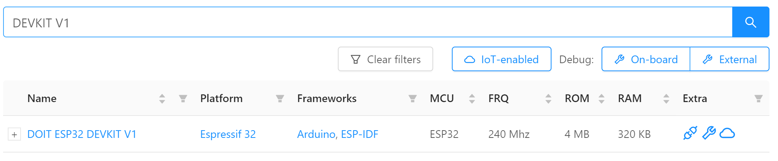
Preperation – Platform Installation
PIO Home should have opened automatically
If not, reload your IDE or press:
Switch to „boards“
Search for your board (e.g „Devkit V1“)

Slide 21
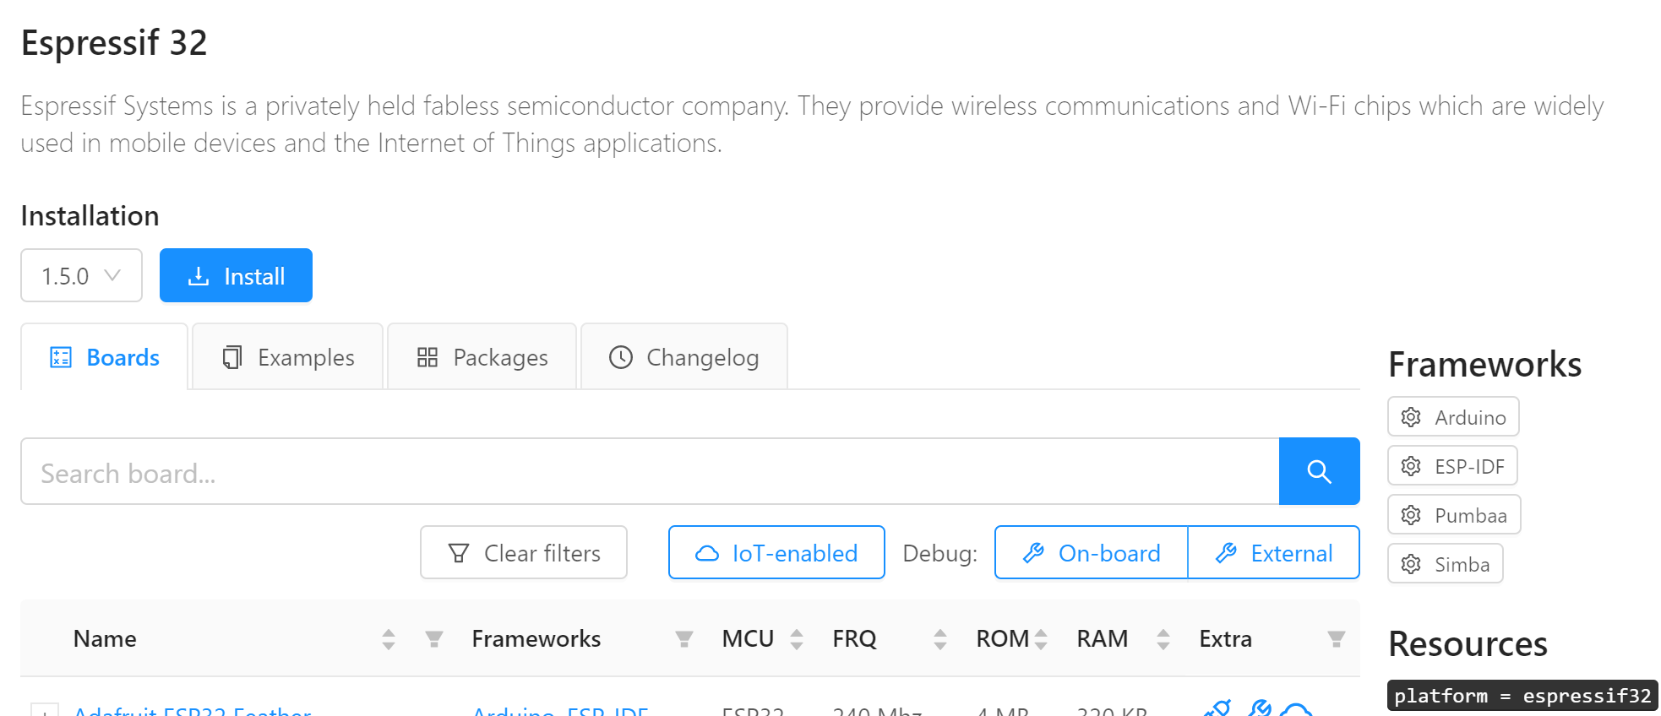
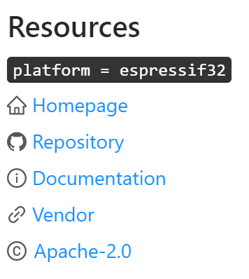
Preperation – Platform Installation
Click on the platform name
Hit „Install“

Slide 22
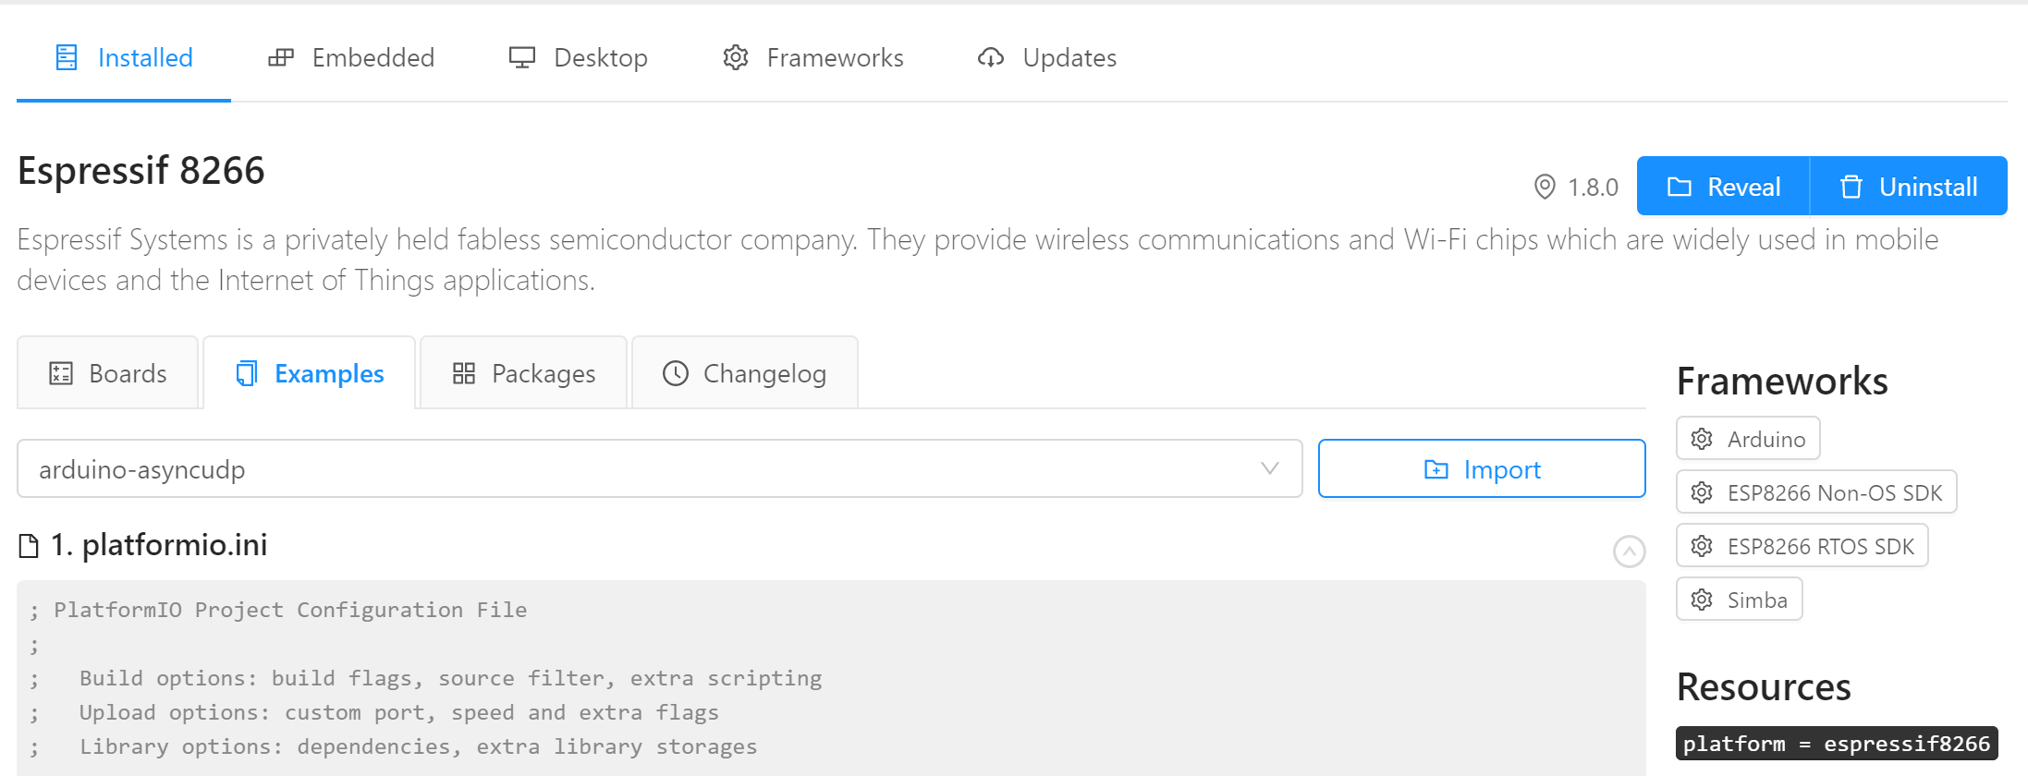
Preperation – Platform Installation
Check the examples to get familiar with your platform:

